Slide 1
DEI Report
Don S. Dizon, MD
Vice Chair, DEI and Professional Integrity
Legorreta Cancer Center and Lifespan Cancer Institute

Slide 2
Our web page- https://thehopefoundation.org/dei-swog/

Slide 3
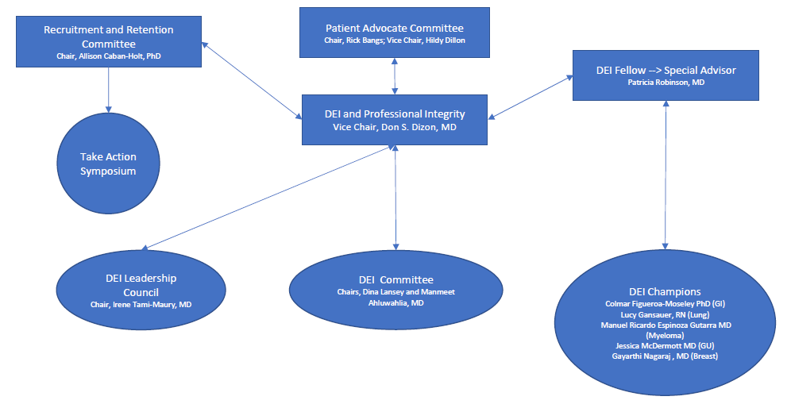
The Crrent Landscape: Pre-Spring Meeting

Slide 4
DEI Committee
Formerly, the DEI Monitoring Committee
Will focus on foundational principles
Pope Consulting Report on DEI will be the guide to operationalize DEI efforts
Look at SWOG policies to identify gaps
Establish DEI language for SWOG policies/procedures
Define standardized review
Establish framework for SWOG to realize DEI principles
Co-Chairs: Dina Lansey, MSN and Manmeet Ahluwalia, MD (Site PI)
Jared Acoba, MD (UH Cancer Center)
Joël Pointon, MSPH (Patient Advocate)
Kathy Crew, MD, MS (Exec Officer)
Desiree Walker, BA (RRC)
Operations: Dana Sparks, MAT (Ops)
Katherine Guthrie, PhD (Biostatistics)

Slide 5
DEI Committee
Develop new and standardized (uniform) policies, e.g., for choosing SWOG study chairs or champions, that encourage DEI and junior investigators and collaboration
•Need for a process to determine the interests of committee members in serving as a study PRO chair, TM chair, etc.
Formerly, the DEI Monitoring Committee
Will focus on foundational principles
Pope Consulting Report on DEI will be the guide to operationalize DEI efforts
Look at SWOG policies to identify gaps
Establish DEI language for SWOG policies/procedures
Define standardized review
Establish framework for SWOG to realize DEI principles

Slide 6
Inaugural projects
Membership Survey
Rick Bangs, lead
Activates in phases, phase 1 live this summer
Aim: Engage all SWOG members to participate in expanded data collection
Goal: Ability to describe membership in a deeper way
Please encourage participation, even after the meeting: visit: swog.org/who-are-we
More about it at The Front Line: https://www.swog.org/news-events/news/2023/04/02/membership-profiles-will-answer-who-are-we

Slide 7
Inaugural projects
Lead by Patricia Robinson, MD
Project 1: DEI Dashboard
Goal: To allow sites ability to see who they are enrolling from a DEI lens
Allow for cross-site comparisons
Project 2: DEI Checklist for Principal Investigators
Goal: To promote intentionality in trial design and development

Slide 8
Coming to the Fall Meeting
DEI Town Hall
Meet DEI leads and committee members
Ask questions, Get answers
Engage in our efforts
Community Advocate Meet-up
Ask questions about the groups they represent
Develop better understanding of unique needs in their own communities
Help them help inform your committee and your work

Slide 9
Three words to describe DEI at SWOG
Intentional
Intersectional
Integrated
Iterative

Slide 10
I want to hear from you
https://thehopefoundation.org/dei-swog/

