Slide 1
DEI at SWOG

Slide 2
Mission & Values
What We Do
SWOG Cancer Research Network's mission is to significantly improve lives through cancer clinical trials and translational research.
What We Believe
Patients are our absolute highest priority
We ensure that the best science drives our research
We embrace and encourage diversity in leadership and membership to effectively solve problems in cancer
We demand integrity, accountability, and ethical behavior
We foster and mentor early-stage investigators to ensure strong leadership and excellent clinical research for future generations

Slide 3
Mission & Values
What We Do
SWOG Cancer Research Network's mission is to significantly improve lives through cancer clinical trials and translational research.
What We Believe
Patients are our absolute highest priority
We ensure that the best science drives our research
We embrace and encourage diversity in leadership and membership to effectively solve problems in cancer
We demand integrity, accountability, and ethical behavior
We foster and mentor early-stage investigators to ensure strong leadership and excellent clinical research for future generations
Research and Trials

Slide 4
Mission & Values
What We Do
SWOG Cancer Research Network's mission is to significantly improve lives through cancer clinical trials and translational research.
What We Believe
Patients are our absolute highest priority
We ensure that the best science drives our research
We embrace and encourage diversity in leadership and membership to effectively solve problems in cancer
We demand integrity, accountability, and ethical behavior
We foster and mentor early-stage investigators to ensure strong leadership and excellent clinical research for future generations
Research and Trials
Patients as partners

Slide 5
Mission & Values
What We Do
SWOG Cancer Research Network's mission is to significantly improve lives through cancer clinical trials and translational research.
What We Believe
Patients are our absolute highest priority
We ensure that the best science drives our research
We embrace and encourage diversity in leadership and membership to effectively solve problems in cancer
We demand integrity, accountability, and ethical behavior
We foster and mentor early-stage investigators to ensure strong leadership and excellent clinical research for future generations
Research and Trials
Patients as partners
Workforce and leadership

Slide 6
DEI at SWOG is integrated in the group mission and values
SWOG Pillars
Research and Trials
Patients as partners
Workforce and leadership
Diversity, Equity, and Inclusion

Slide 7
Mission Statement: PAC
None clearly delineated
As described on website:
Advocates serve as the voice of the patient in the development and execution of our trials.

Slide 8
DEI at SWOG is integrated in the group mission and values
Research and Trials
PAC
Patients as partners
Workforce and leadership

Slide 9
Recruitment and Retention Committee
The RRC has a special focus on diversity and defines underrepresented patients broadly, by: race and ethnicity, age, gender, income, sexual orientation and gender identity, language, and geographic location. The RRC’s mission is not only to increase diversity in SWOG trials, and in its membership and leadership, but to execute an action plan that includes:
Consulting with SWOG principal investigators on protocol-specific recruitment and retention strategies
Creating and maintaining a recruitment and retention toolbox for SWOG members
Developing and implementing recruitment and retention initiatives, including catchment area planning, accrual planning, and diversity accrual
Presenting to, and collaborating with, other SWOG committees
Initiating and contributing to diversity, recruitment, and retention publications
Surveying SWOG members to capture group demographics

Slide 10
Recruitment and Retention Committee
The RRC has a special focus on diversity and defines underrepresented patients broadly, by: race and ethnicity, age, gender, income, sexual orientation and gender identity, language, and geographic location. The RRC’s mission is not only to increase diversity in SWOG trials, and in its membership and leadership, but to execute an action plan that includes:
Consulting with SWOG principal investigators on protocol-specific recruitment and retention strategies
Creating and maintaining a recruitment and retention toolbox for SWOG members
Developing and implementing recruitment and retention initiatives, including catchment area planning, accrual planning, and diversity accrual
Presenting to, and collaborating with, other SWOG committees
Initiating and contributing to diversity, recruitment, and retention publications
Surveying SWOG members to capture group demographics

Slide 11
DEI at SWOG is integrated in the group mission and values
RRC
Research and Trials
Patients as partners
Workforce and leadership

Slide 12
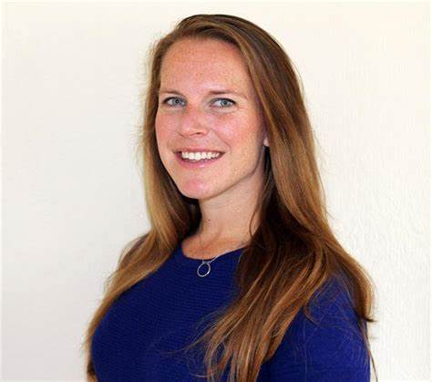
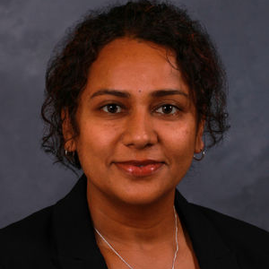
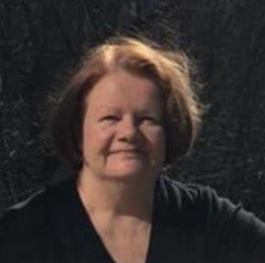
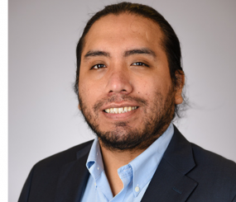
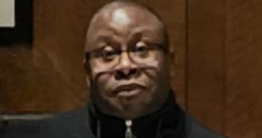
DEI Champions (First Cohort)
DEI champions will work with research committees and study teams during the protocol development process, to build evidence-based action plans that ensure each trial accrues a group of participants that reflects the full diversity of the study population.

Slide 13
DEI at SWOG is integrated in the group mission and values
DEI Champions
Research and Trials
Patients as partners
Workforce and leadership

Slide 14
Primary DEI Initiatives
DEI Checklist
DEI Dashboard
Research and Trials
Patients as partners
Workforce and leadership
Membership
Survey

Slide 15
DEI at SWOG is integrated in the group mission and values
SWOG Mission Values
Research and Training
Patients as partners
Workforce and leadership
Diversity, Equity, and Inclusion
Recruitment and Retention
Patient Advocate Committee
DEI Leadership Council
DEI Champions
Membership Demographics
DEI Checklist
DEI Dashboard

Slide 16
DEI at SWOG is integrated in the group mission and values
Research and Training
Patients as partners
Workforce and leadership
Diversity, Equity, and Inclusion
2023-24 Initiatives: DEI Checklist, DEI Dashboard, Membership survey
Review operations to ensure they reflect DEI principles (Pope)
Career Advancement in DEI
Define DEI metrics for effectiveness

Slide 17
Coming soon
Survey for Committee Chairs
Operations (members, task force)
Activities in DEI
RFP coming for second cohort of DEI Champions
Soliciting your input
Reconstitute a DEI Committee
Workforce/Leadership

Slide 18
DEI and Professional Integrity
Transparent
Inclusive
Iterative
Integrated
We all belong
at SWOG

