Slide 1
DEI Update Spring 2024
Don S. Dizon MD, FACP, FASCO
Professor of Medicine and Professor of Surgery, Brown University
Director, The Pelvic Malignancies Program, Lifespan Cancer Institute
Associate Director, Community Outreach and Engagement, Legorreta Cancer Center at Brown University
Vice Chair, DEI and Professional Integrity, SWOG Cancer Research Network

Slide 2
DEI at SWOG is integrated in the group mission and values
DEI at SWOG is integrated in the group mission and values
SWOG Pillars
Research and Trials
Patients as partners
Workforce and leadership
Diversity, Equity, and Inclusion

Slide 3
DEI review of policies and procedures Dana Sparks (chair); Jacob Acoba, Bernard Parker, Joël Pointon, Desiree Walker, Christa Braun-Inglis, Don Dizon
SYSTEMS Recommendation from Pope Consulting
Review policies from a DEI Lens
What did we consider from a DEI Lens:
Do policies default to masculine pronouns?
Do policies exclude trial participants by gender?
Do the policies intentionally use patient-centric language?
Inclusivity: are criteria specific enough to allow equitable participation?
Do the policies include the members involved in cancer care and research that can be instrumental in the care of study volunteers?
Do the policies speak to both the NCORP and NCTN studies?
Do policies speak towards the inclusion of patient advocates?

Slide 4
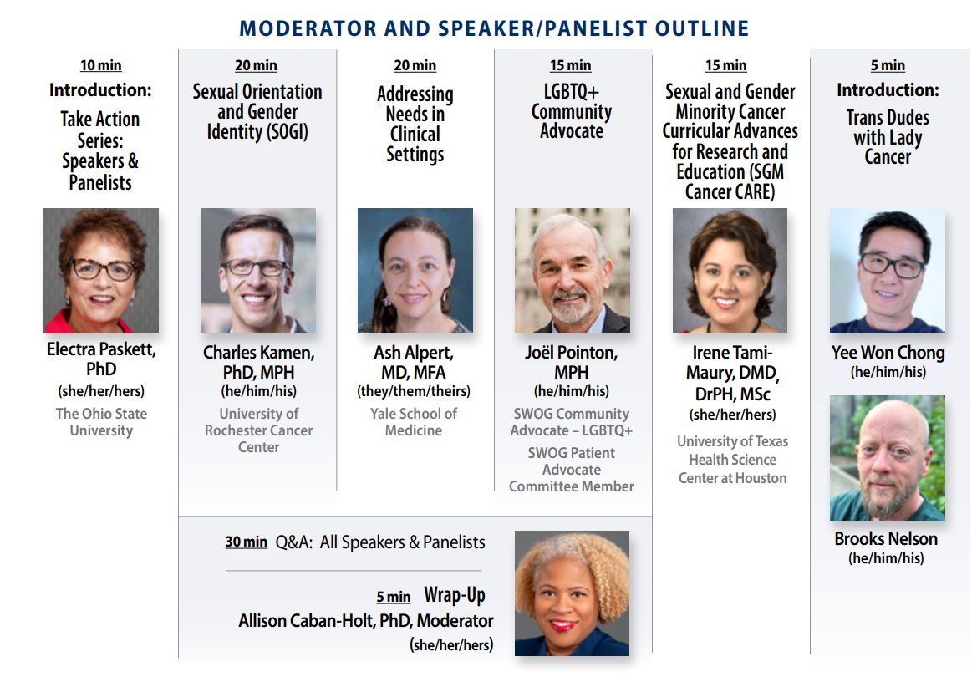
At this meeting

Slide 5
Opportunities

Slide 7
To register:
https://www.ctg.queensu.ca/bulletin/way-forward-virtual-roundtable-improving-equity-and-access-cancer-clinical-trials

Slide 9
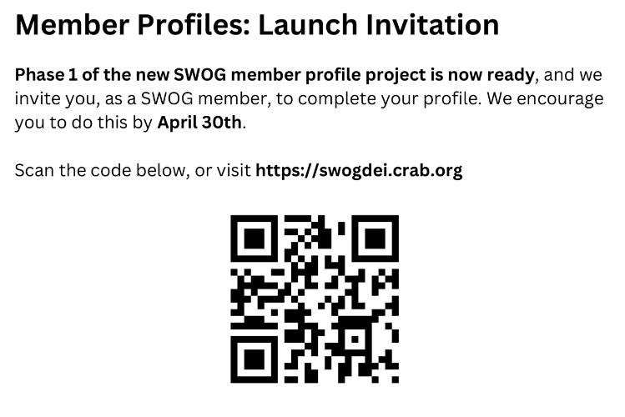
Updates
Membership survey: Phase 1
Professional role
Concentration
Birth year
Cancer specialty
US residence
Work environment
Military
Practice setting
Race and ethnicity
Accessbility needs
College status (first gen vs not)

Slide 10
Committee Operations
Survey from the DEI Leadership Council
Objective: to document committee processes and define:
Consistency versus variability
Impact on inclusivity
Impact on diversity

