Slide 1
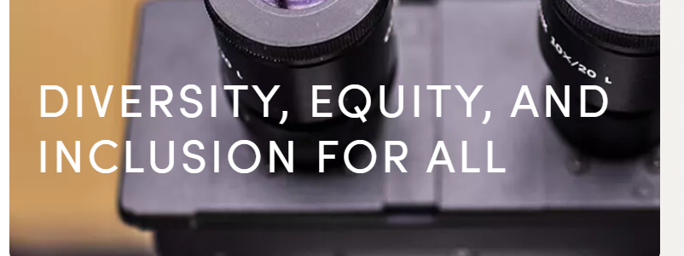
DEI Update Fall 2024
Don S. Dizon MD, FACP, FASCO
Professor of Medicine and Professor of Surgery, Brown University
Director, The Pelvic Malignancies Program, Brown University Health Cancer Institute
Associate Director, Community Outreach and Engagement, Legorreta Cancer Center at Brown University
Vice Chair, DEI and Professional Integrity, SWOG Cancer Research Network

Slide 2
DEI review 2: Protocol and IC templates
Changes to Protocol Template
Addition of community-center based chair
Changes to consent
Universal use of health care provider rather than doctor
Use of study specific eligibility (labs/con meds/comorbidities)
Bear in mind rural communities in study procedures, including shipping of specimens, timing, assessments
Training requirements to acknowledge community based providers
Include formal review from ORP
Be congizant of gender vs sex in data collection
Inclusive language, including pronouns (he/she/they)

Slide 3
At this meeting

Slide 4
Committee Leadership Survey
Survey from the DEI Leadership Council
Objective: to document committee processes and define:
Consistency versus variability
Impact on inclusivity
Impact on diversity

Slide 5
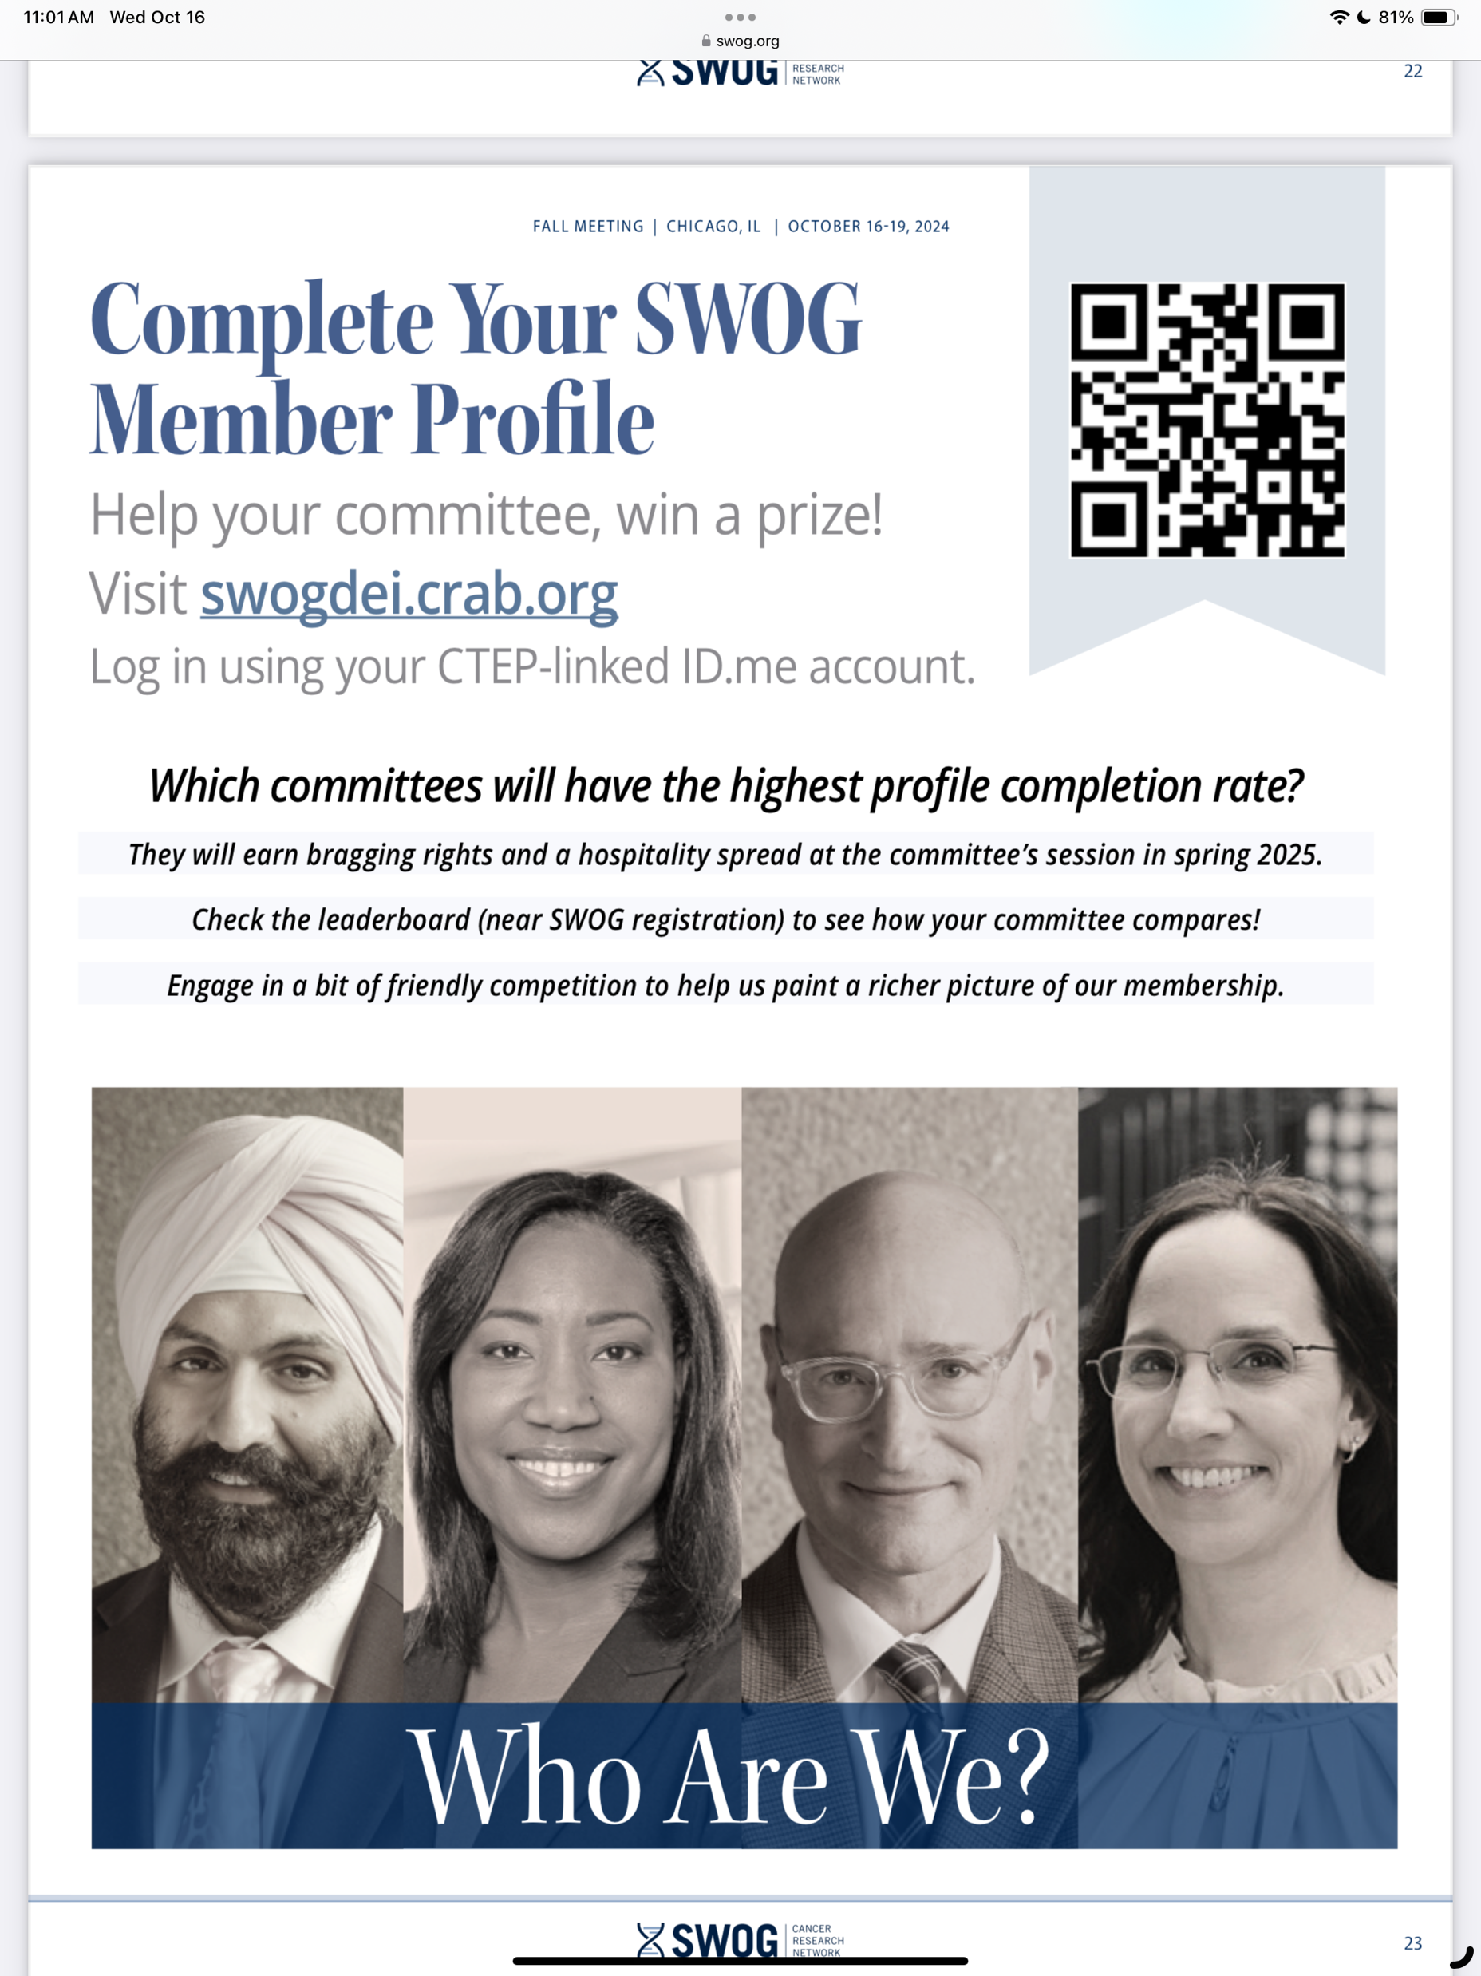

Slide 6
Where are we going next? Phase 2 data collection
Membership profiles lead, Rick Bangs

Slide 7
Scope and Timing
Phase | Scope
Phase 1 (Mar 2024) | Vision and Core Data: building blocks/foundation
Phase 2 (winter 2024-25) | Additional Information: adds sensitive data, new membership entries, non-US; standard reporting and output data to dashboard
Phase 3 (2025; requires incremental budget) | Networking and Connectivity, advanced reporting

Slide 8
Sex
Current State | Recommendation (NIH)
 | What sex were you assigned at birth, on your original birth certificate?
Male | MALE
Female | FEMALE
 | I prefer not to answer
 | DON'T KNOW

Slide 9
Gender Identity and Sexual Orientation
Current State | Recommendation (ASCO)
 | Which of the following best describes you?
Male | Female
Female | Male
 | Non-binary
 | Self-identify as ___________
 | I prefer not to answer

Slide 10
Gender identity and Sexual Orientation
Current State | Recommendation (ASCO)
 | Do You Identify as Transgender or Gender Diverse?
Male | Yes
Female | No
 | I prefer not to answer

Slide 11
Sexual Orientation
Current State | Recommendation (ASCO)
 | How Would You Describe Your Sexual Orientation? (select all that apply)
N/A | Asexual
 | Bisexual
 | Gay
 | Heterosexual or Straight
 | Lesbian
 | Queer
 | Two-Spirit
 | Self-Identify as _______
 | Prefer not to answer
Notes:
The following is a non-exhaustive list of different types of sexuality:
1. Allosexual
Allosexual refers to those who experience sexual attraction to others. Allosexual individuals can be bisexual, pansexual, queer, gay, lesbian, heterosexual, or so forth. Some note allosexual is the opposite of asexual.⁴
2. Allotroposexual
Allotroposexual is a relatively new term used to replace skoliosexual. It refers to individuals whose primary attraction is to transgender or non-binary individuals. The term does not refer to the fetish, sexualization, and objectification of trans people by cisgender individuals.
3. Androsexual
Androsexual individuals are attracted to masculinity regardless of the person’s sex or gender. For some, this could best be described as being attracted to masculine expression, presentation, or characteristics.
4. Asexual (Aces)
People who are asexual experience little or no sexual attraction to others or have limited to little desire for sexual contact. It’s important to remember not all asexual folks are repulsed or refuse sex. People who identify as asexual don’t always experience no desire for romance and may have many successful relationships regardless of sexual contact.
5. Bicurious
Someone who is bicurious has historically been heterosexual, but is considering or curious about engaging in sexual activity with an individual who may have a sex or gender different than their partners in the past. The word “curious” should always be used instead of confused to help decrease the shame and stigma often associated with non-heterosexual activity.
6. Bisexual
A bisexual individual experiences sexual attraction to both sexes and genders. Recent research shows that the bisexual+ or bi+ (an identity label that encompasses all non-monosexual identities) female population in the US is larger than that of lesbians, gay men, and bi+ men combined.⁵
7. Ceterosexual
Ceterosexual is another term used to describe an individual who is attracted to transgender or nonbinary individuals. The term does not refer to the fetish, sexualization, and objectification of trans people by cisgender individuals.
8. Demisexual
A person who is demisexual often feels sexual attraction after building an emotional bond or connection with someone. Those who are demisexual note they do not feel immediately attracted to individuals based on looks, smell, and other features.
9. Fluid
Fluid individuals’ sexuality changes and is not fixed. Many folks can resonate with their sexuality being stable, but some feel their sexuality is ever-changing. Fluid individuals can also utilize other sexual orientation terms to describe themselves or may feel they do not resonate with any of them.
10. Gay
A gay man’s primary sexual attraction is to other men. This includes transgender men who are attracted to other men. Some have also used gay to refer to LGBTQ+ community as a whole.
11. Graysexual
Graysexual individuals don’t identify as asexual, but also feel less sexual attraction than most folks. Therefore, they fall into the gray area of sexuality. It can be helpful to think of asexuality as a spectrum and see graysexual as a part of this spectrum.
12. Gynosexual
Gynosexual individuals are attracted to femininity regardless of the person’s sex or gender. For some, this could best be described as being attracted to feminine expression, presentation, or characteristics.
13. Heterosexual
Those attracted to individuals of the opposite sex or gender are referred to as heterosexual or “straight.” For example a woman who is attracted to men. Cisgender, transgender, and non-binary folks can all identify as heterosexual.
14. Homosexual
Homosexuality refers to those who are attracted to individuals of the same sex or gender. For example, a woman who is attracted to women. Cisgender, transgender, and non-binary folks can all identify as homosexual. However, many now feel this term is a bit outdated and clinical. The term is also now heavily used by many anti-LGBT groups, making it less used by LGBTQ+ folks and allies.
15. Lesbian
A lesbian woman’s primary sexual attraction is to other women. This includes transgender women who are attracted to other women whether cisgender, transgender, or non-binary. There is a common misconception lesbian women are also transmen. Remember, sexuality and gender are not the same.
16. Libidoist Asexual
These individuals are asexual, but experience sexual feelings and satisfy these through self-stimulation or masturbation. As mentioned above, asexual people are not always completely avoidant of sexual attraction, feelings, or urges. For some, satisfying these needs is more pleasurable without a partner.
17. Monosexual
Mono means “one”. Monosexual individuals are sexually attracted to one sex or gender only. These folks could be heterosexual or homosexual. Monosexual people may use this term for many reasons, whether it be homosexual or heterosexual doesn’t feel right for them, or they just want to use a more inclusive term.
18. Multisexual
Multisexual individuals are attracted to multiple sexes or genders. Historically, this term has been used to include those who may have sex characteristics outside of male or female and also to be inclusive of trans folks.
19. Omnisexual
Individuals who are attracted to “all” individuals regardless of sex or gender often identify as omnisexual. Most LGBTQ+ folks grow up without language that represents their thoughts, feelings, and emotions, and because of this have to create their own. While terms’ meanings may sound similar to you, they hold importance to the person using them, and this should be respected.
20. Pansexual
People who identify as pansexual are attracted to individuals regardless of their sex or gender. The original term was first coined by Sigmund Freud as “pan-sexualism.” The term has come a long way and even has its own history of advocacy and activism.
21. Polysexual
Poly stems from the Greek prefix for “many,” so polysexual individuals are attracted to multiple or many genders or sexes. Some people assume polysexual is the same as polyamory, but they are not used interchangeably. Polysexual folks also do not always engage in polyamorous relationships.
22. Queer
Queer is an umbrella term used for those who are not heterosexual or cisgender. Queer was historically used as a slur to refer to LGBTQ+ individuals, but in recent years has been liberated and taken back by the community. It’s important to remember the history of the term and realize there are still some LGBTQ+ individuals who consider this term offensive or degrading. Therefore, it’s important to only use the term if someone has expressed comfort with it.
23. Sapiosexual
Sapiosexual individuals experience sexual attraction based on intelligence vs. sex or gender. Both LGBTQ+ folks and heterosexual folks can be sapiosexual. Sapiosexual individuals may also still find physical characteristics or qualities attractive, but it is not the most important.
24. Skoliosexual
Skoliosexual individuals are attracted to those who are transgender or non-binary. This term has become controversial in nature and is no longer a preferred term. Instead, the above terms of Allotroposexual and Ceterosexual are used.
The term does not refer to the fetish, sexualization, and objectification of trans people by cisgender individuals. However, it has been used in this way, putting trans folks in danger. The controversy also stems from the meaning of “scolio” which means “crooked,” “bent,” or “twisted” and carries negative connotations.⁶
25. Spectrasexual
Spectrasexual individuals are attracted to multiple sexes and genders, but not necessarily all or any. At times there can be some debate about the use of spectrasexual. Some people find the term problematic, as they feel it provides an avenue for certain folks to be discriminated against. Others feel it gives them the fluidity they desire.

Slide 12
Preferred Pronouns
Current State | Recommendation
 | Which pronouns do you prefer?
 | He/him
 | She/her
 | They/them
 | Other: _______
 | Prefer not to say
Notes:
To be validated
Radio button or check boxes

Slide 13
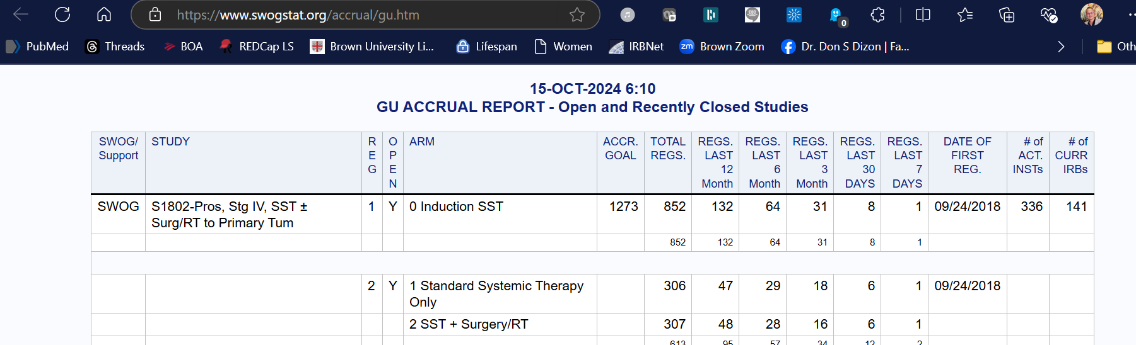
SWOG Resources
Patient Advocacy Council
Pitch the PAC
Recruitment and Retention Committee
Utilize expertise proactively not in response to problems
Digital Engagement Committee
Social media toolkit
Active monitoring
Accrual Dashboard
Coming soon!
DEI Dashboard

Slide 16
The DEI Checklist: Coming Soon
PROTOCAL DESIGN AND REGISTRATION
Study PI/team complete module 6
Identify inclusion team
PAC, RRC, statistician, *DEI committee lead
Measure rationale relative to impact on scientifically diverse populations
Consider supplementary table that provides background information on scientific diversity
Review eligibility for bias
Filter out race-based tools, gender specificity, co-morbidities
Create statistical goals in collaboration with statistician
Review sites that serve target populations
Study available in institutions with target population/ scientifically diverse population
Study accessible to scientifically diverse populations
Confirm gender neutral / patient centric language; racial and ethnic categories
*Review protocol with RRC as it relates to DEI
Construct a data sharing plan
PARTICIPANT ENROLLMENT
*Monthly assessment of recruitment
Address accrual with committee
Report at semi-annual committee meeting
Discuss countermeasures as applicable
*Review accrual progress with RRC
Strategize with PAC
STUDY COMPLETION
Report actual accrual relative to forecasted
Manuscript development / publication
Confirm gender neutral / patient centric language; racial and ethnic categories
Communication to community

