Slide 2
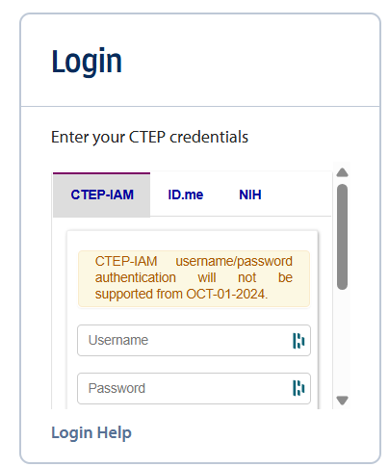

Slide 3
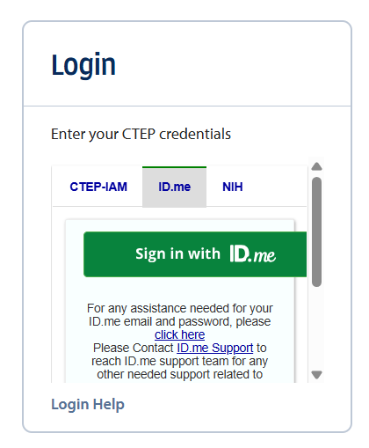

Slide 4
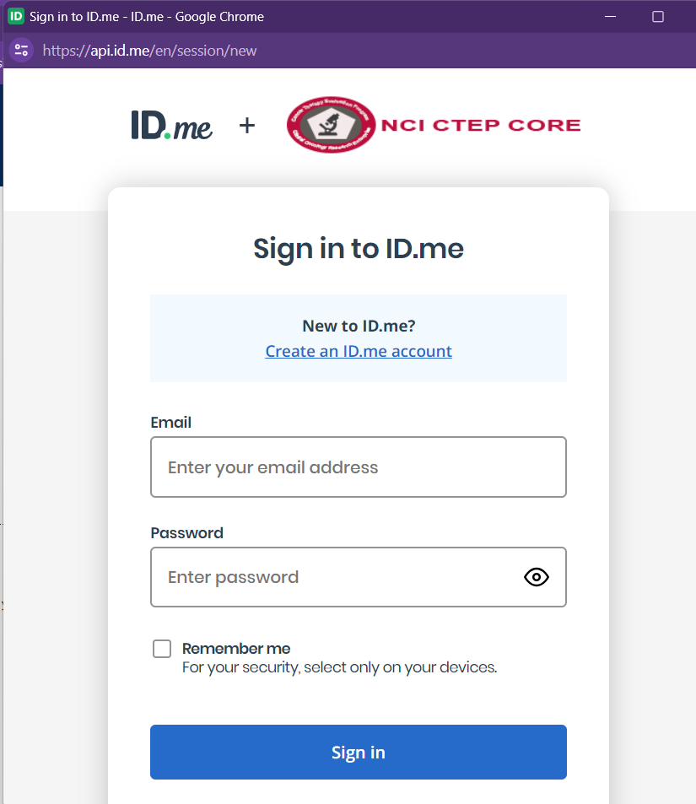

Slide 5
Update my profile

Slide 7
Data stored at: swogdeicrab.org

Slide 8
This Photo by Unknown Author is licensed under CC BY-SA-NC

